Slide 1
Leadership

Slide 2
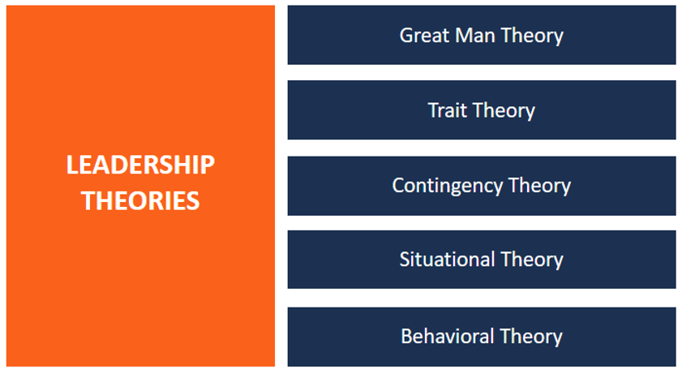
The Parameters: * Ability to develop a vision * Motivating * Promoting Cohesion * Influencing towards accomplishments

Slide 3
Great Man Theory
* Leaders are born not made.
* Leader emerges when the situation arises.
Trait Theory
* Gene and socializing play a crucial role.
* Right combination of traits to make a leader
Contingency & Situational Theory
* Flexibility in its approach.
* No fixed best style of leadership.
* Situational based.
Behavioral Theory
* Leadership traits can be learned/taught/imbibed

Slide 4
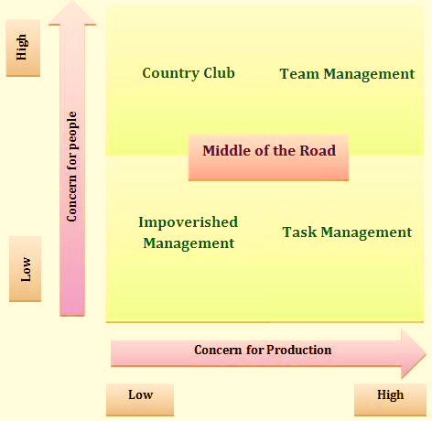
Blake & Mouton Grid
Introspection of why some company perform better than others

Slide 5
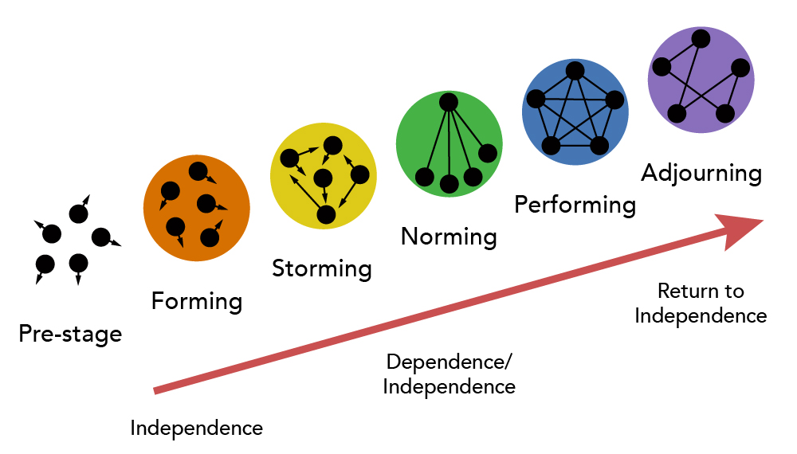
Tuckman’s Team Building/Group Formation Process

Slide 6
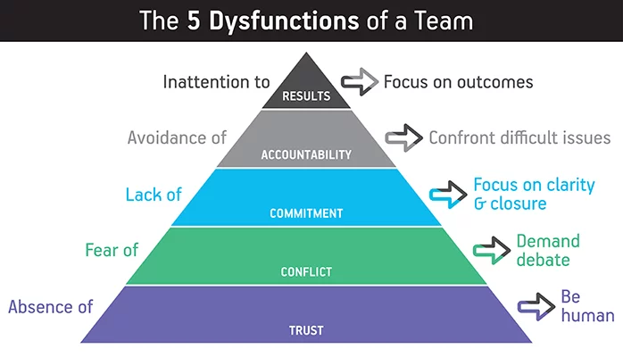
Lencioni’s Description of Dysfunctioning

Slide 7
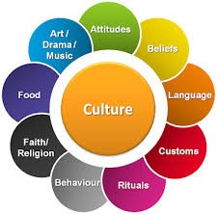
Org./ Corporate Culture
Co. beliefs, values, attitude etc. that guide the behavior of employees

Slide 8
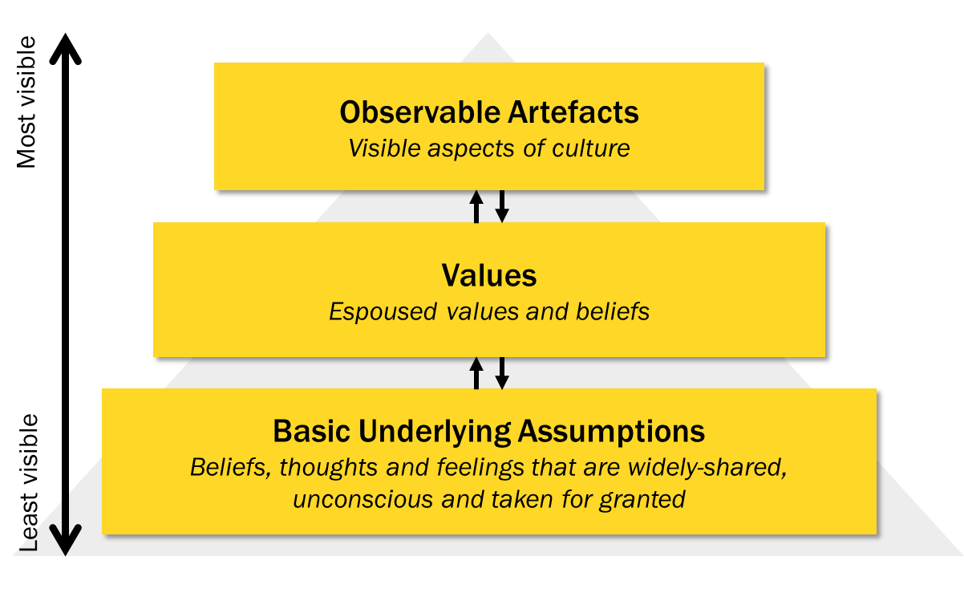
Org. Culture Levels
Artefacts: Obvious, visible (furniture, decor items, uniform etc.)
Values: Declared set of beliefs, code of conduct.
Assumptions: Unconscious, Intangible in nature

Slide 9
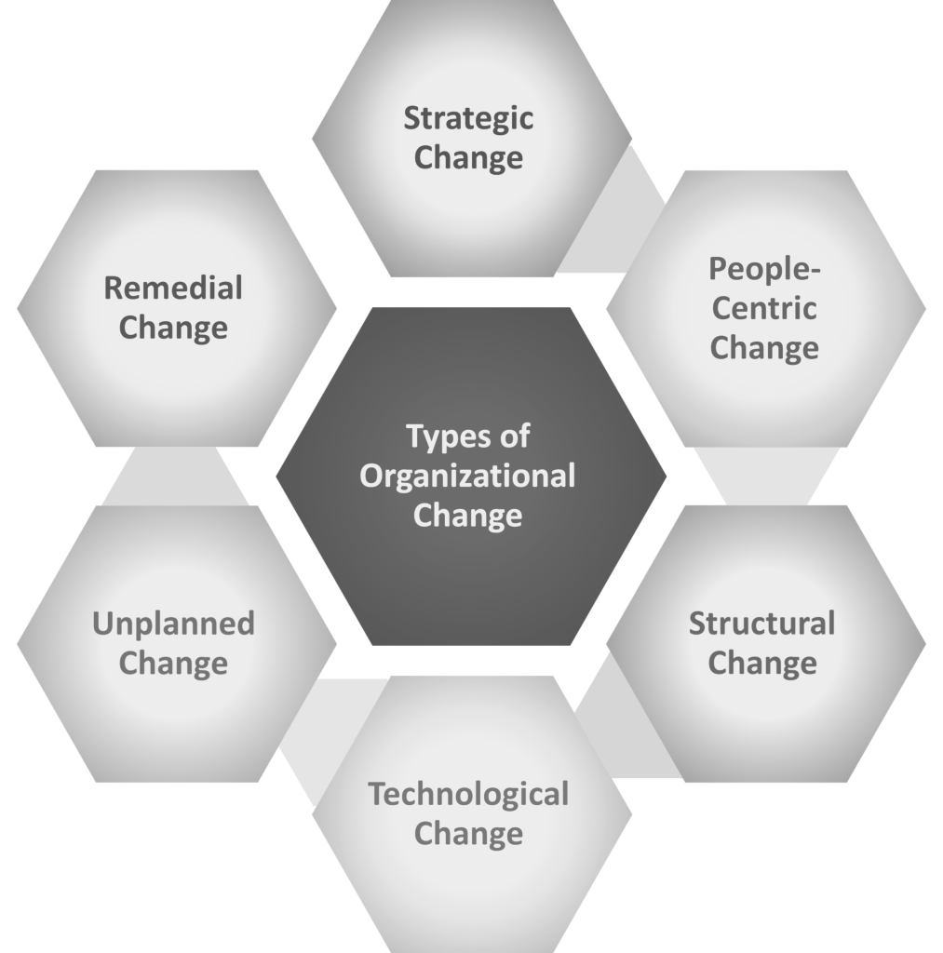
Org. Change Major restructuring

Slide 10
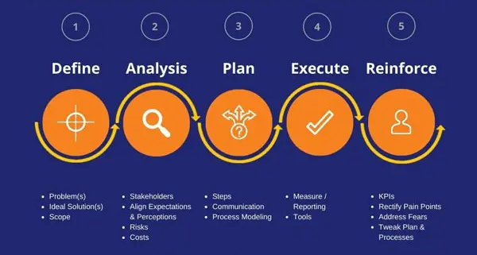
Change Management Process

Slide 11
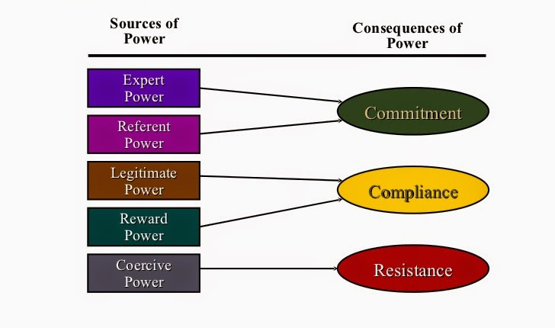
Power Dynamics Balance OR imbalance in Org. relationship

Slide 12
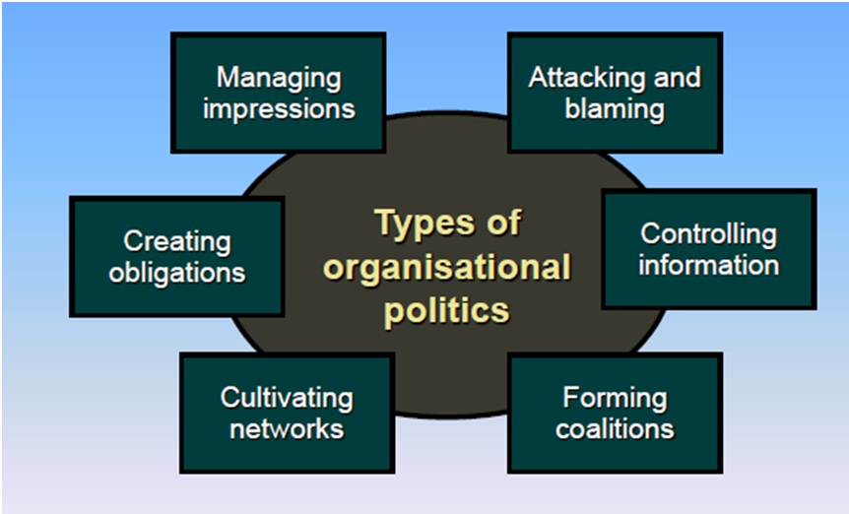
Politics & Org. Endeavors undertaken to gain power and accomplish goals

Slide 13
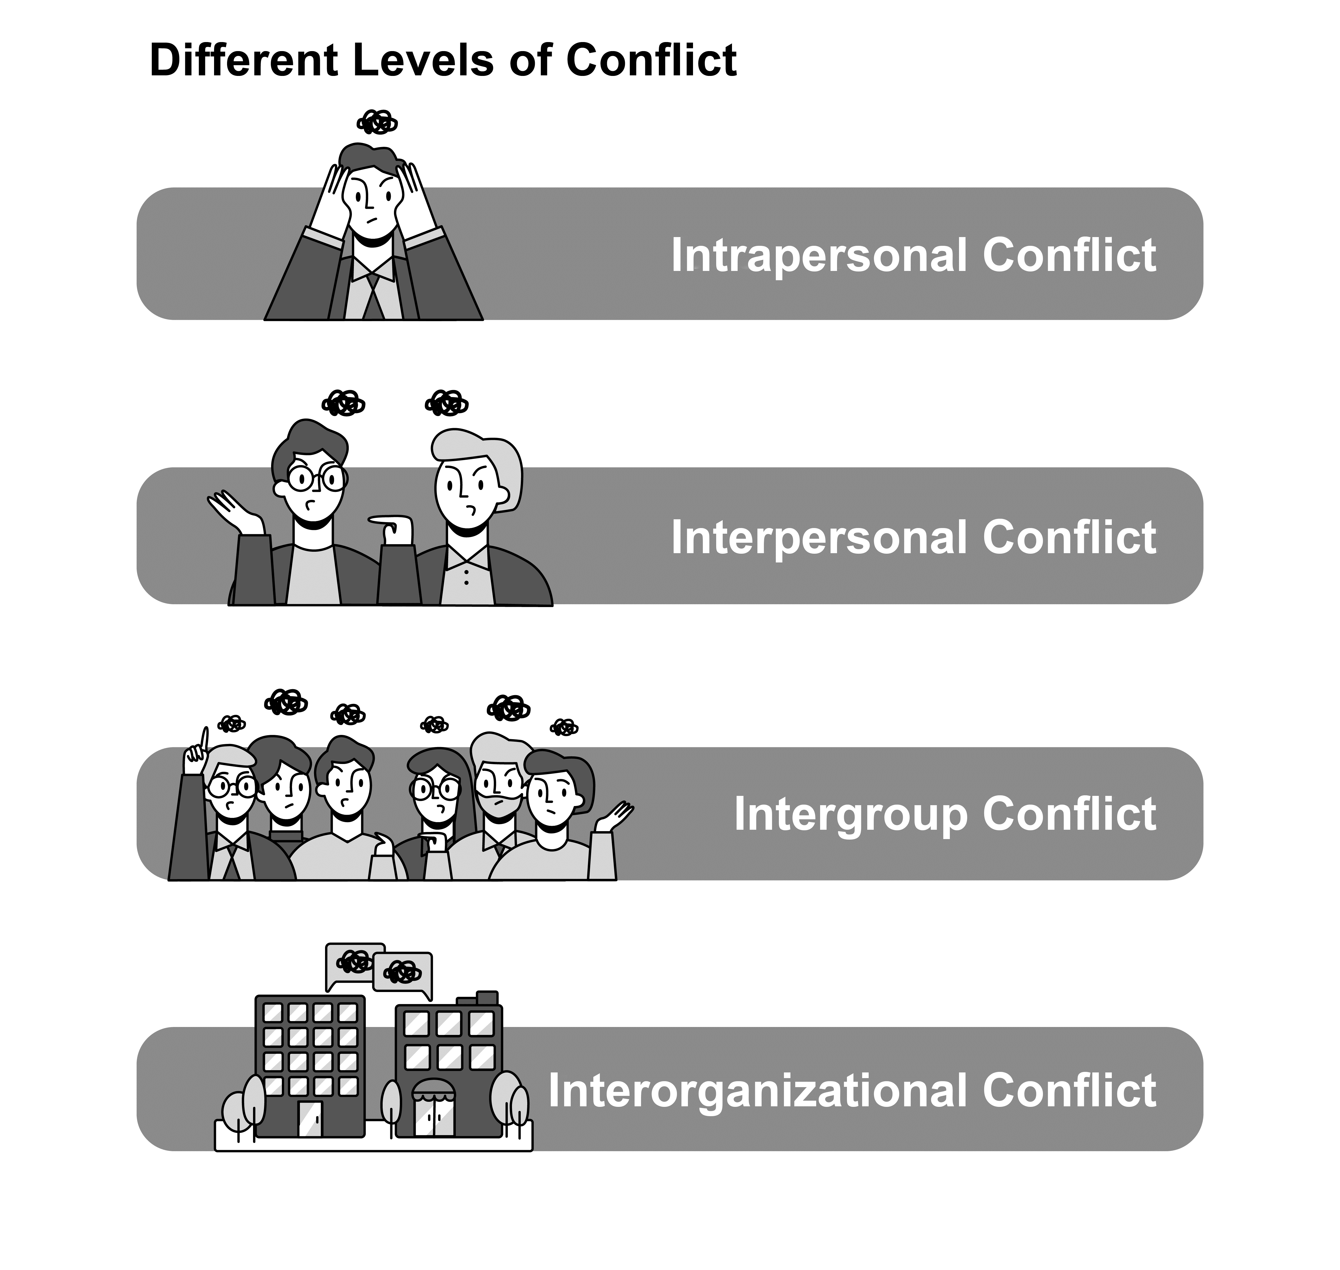
Conflict & Org.

Slide 14
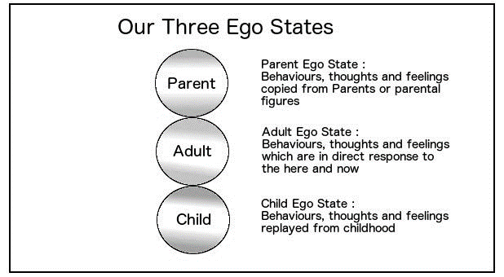
Transaction Analysis ( TA )
Interaction between Individuals/Groups lead to Social Transactions.
These are psychological in nature.
Behavior are action & reaction oriented
Human personality has three ego states Parent, Adult & Child.
The ego states portray diverse thoughts, behavior and feeling.

Slide 15
